Slide 1
Object Oriented Programming IT-1203
Jesmin Akhter
Professor, IIT, JU

Slide 2
Polymorphism
Polymorphism, a Greek term, means the ability to take more than one form.
An operation may exhibit different behavior in different instances
The behavior depends upon the types of data used in the operation.
For example a single function name can be used to handle different number and different types of argument. This is something similar to a particular word having several different meanings depending upon the context.
Another example, consider the operation of addition.
For two numbers, the operation will generate a sum.
If the operands are strings, then the operation would produce a third string by concatenation.
Polymorphism is extensively used in implementing inheritance.

Slide 3
In C++ polymorphism is mainly divided into two types:
Polymorphism
Compile time Polymorphism
Runtime Polymorphism
Notes:
https://www.slideshare.net/AdilAslam4/polymorphism-in-c-69354321

Slide 4
Compile time Polymorphism
Compiler is able to select the appropriate function for a particular call at the compile time itself. This is called the early binding or static binding or static linking. Early binding simply means that an object is bound to its function call at compile time.
This type of polymorphism is achieved by function overloading or operator overloading.
Function Overloading: When there are multiple functions with same name but different parameters then these functions are said to be overloaded. Functions can be overloaded by change in number of arguments or/and change in type of arguments.
So for using a single function name to perform different type of task is known as function overloading.
Notes:
https://www.slideshare.net/AdilAslam4/polymorphism-in-c-69354321

Slide 5
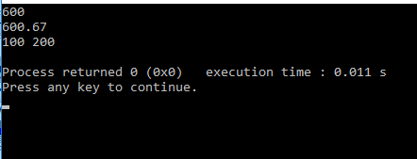
// C++ program for function overloading #include <iostream> using namespace std; class overload { public: void func(int i) { int x=i; cout<<x<<endl; } void func(double d) { double x=d; cout<<x<<endl; } void func(int i, int j) { int x=i, y=j; cout<<x<<" "<<y<<endl; } }; In the above example, a single function named func acts differently in three different situations which is the property of polymorphism.
int main()
{
overload obj;
obj.func(600);
obj.func(600.67);
obj.func(100,200);
return 0;
}

Slide 6
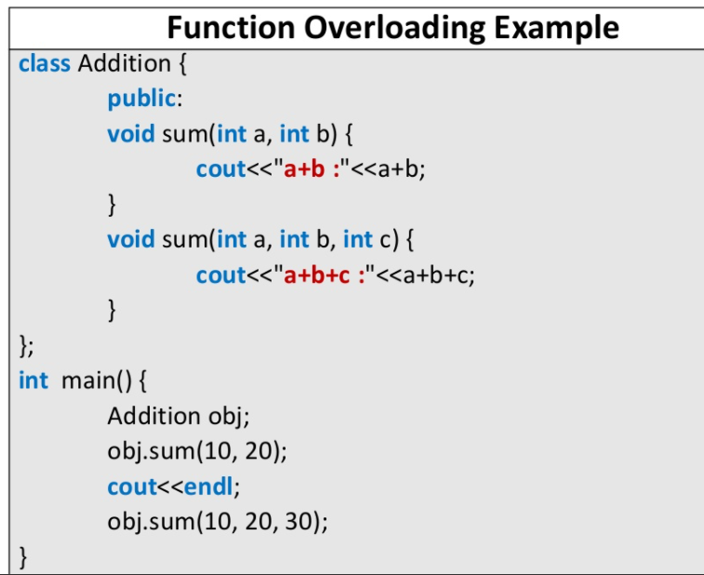

Slide 7
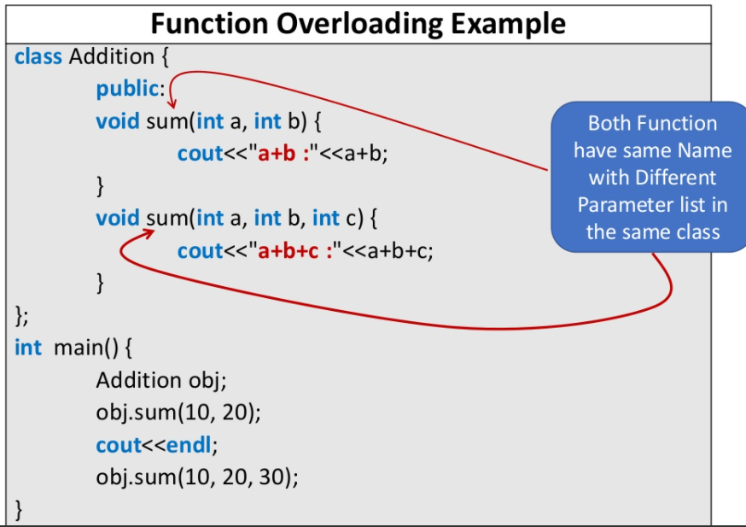

Slide 8
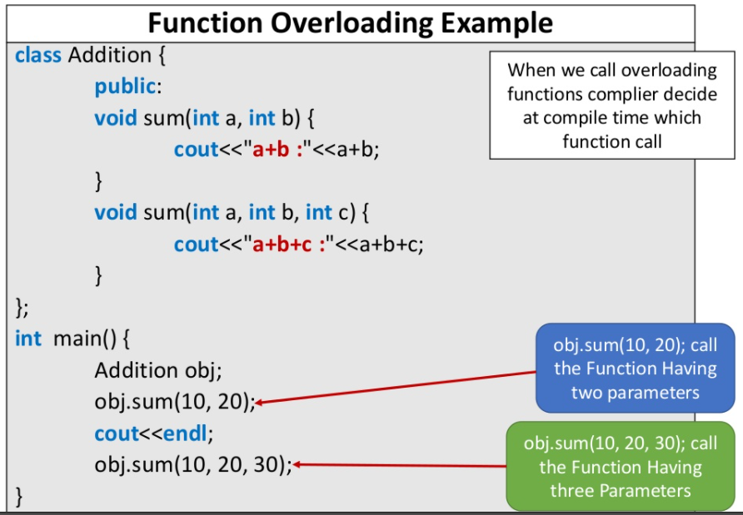

Slide 9
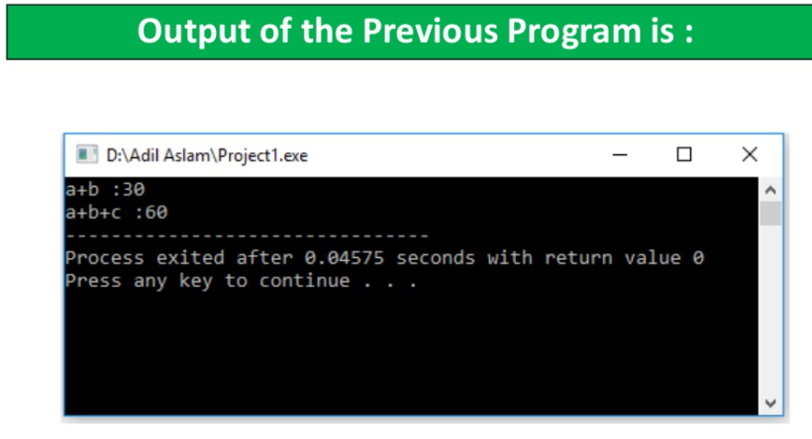

Slide 10
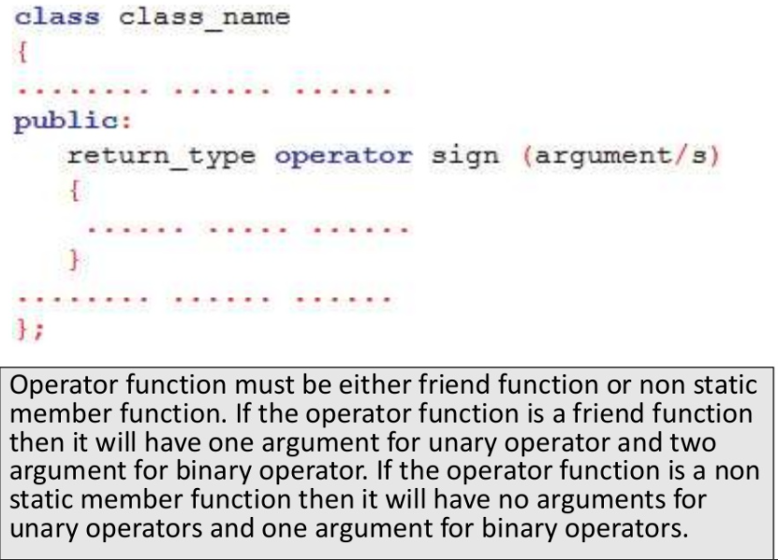
Operator Overloading: C++ also provide option to overload operators. For example, we can make the operator (‘+’) for string class to concatenate two strings. We know that this is the addition operator whose task is to add to operands. So a single operator ‘+’ when placed between integer operands , adds them and when placed between string operands, concatenates them.
The process of making an operator to exhibit different behaviors in different instances is known as operator overloading.

Slide 11
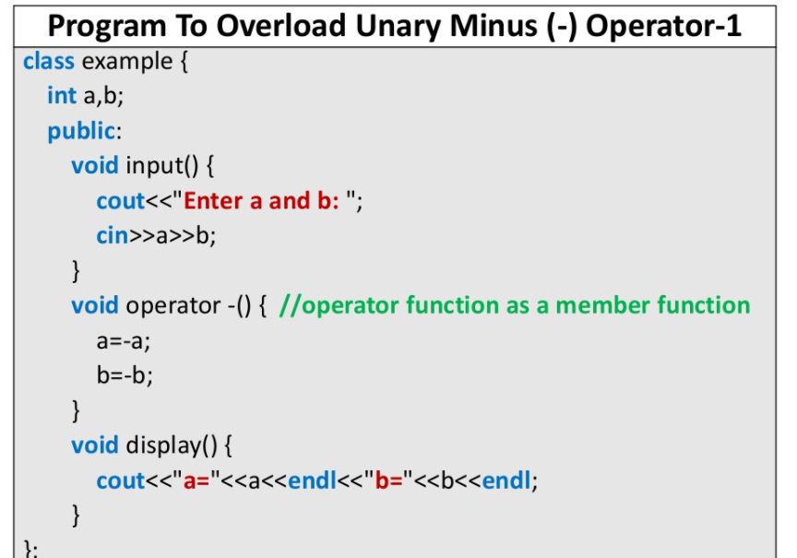
Example 1

Slide 12
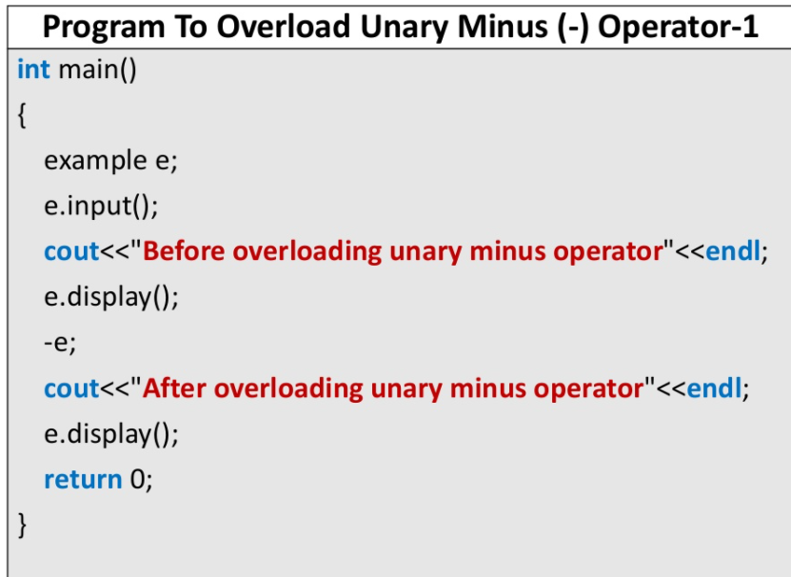

Slide 13
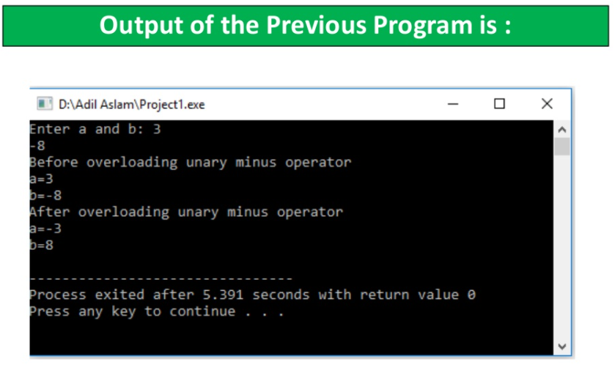

Slide 14
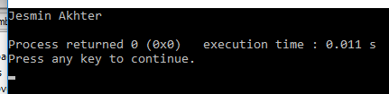
Example 2 Operator Overloading:
#include <iostream>
using namespace std;
class stringoverload
{
string a;
public:
void setData(string x)
{
a=x;
}
void display()
{
cout<<a<<endl;
}
stringoverload operator +(stringoverload name)
{
stringoverload temp;
temp.a=a+name.a;
return temp;
}
};
int main()
{
stringoverload str1,str2,str;
str1.setData("Jesmin ");
str2.setData("Akhter");
str=str1+str2;
str.display();
return 0;

Slide 15
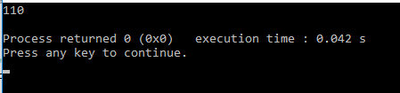
Example 3 Operator Overloading:
#include <iostream>
using namespace std;
class integer
{
int a,b;
public:
void setData(int x)
{
a=x;
}
void display()
{
cout<<a<<endl;
}
integer operator +(integer val)
{
integer temp;
temp.a=a+val.a;
return temp;
}
};
int main()
{
integer i1,i2,i;
i1.setData(50);
i2.setData(60);
i=i1+i2;
i.display();
return 0;
}

Slide 16
Thank you

